Slide 1
Differential Privacy
Jalaj Upadhyay
Notes:
Hello everybody, thanks a lot for coming to this talk. I am Jalaj Upadhyay, a postdoc at JHU working with Raman and Vladimir.
Today, I am going to talk about some of our recent works on differential privacy in non-convex learning.
Our aim in this talk is to give a different perspective of learning while preserving privacy of the underlying data.

Slide 2
Learning Using Private Data: Naïve View
Statistics
Privacy
Statistics and Privacy seems conflicting!
Think about computing mean of numbers
Notes:
If you ask a person, what does he thinks about learning and privacy?
A most probable answer would be that learning and privacy are incompatible. Intuitively if you learn something using some underlying data, it means you are violating privacy of the users in the data.

Slide 3
Statistics Using Private Data: DP View
Statistics
Privacy
Notes:
We have a different view. In this talk, we will show that there are settings where learning and privacy are compatible.
In fact, we believe that privacy and learning are more compatible that what meets the eyes.
If you want to take anything away from this presentation, this is the slide I would like you to remember.

Slide 4
Data analysis on collected data
➢ Privacy issues
➢ Too big to store
➢ Distributed
➢ Cryptographic solution are too expensive
Notes:
So, let us try to address the elephant in the room.
Any learning happens on some training data.
We will address all these three issues as we go along starting with privacy.

Slide 5
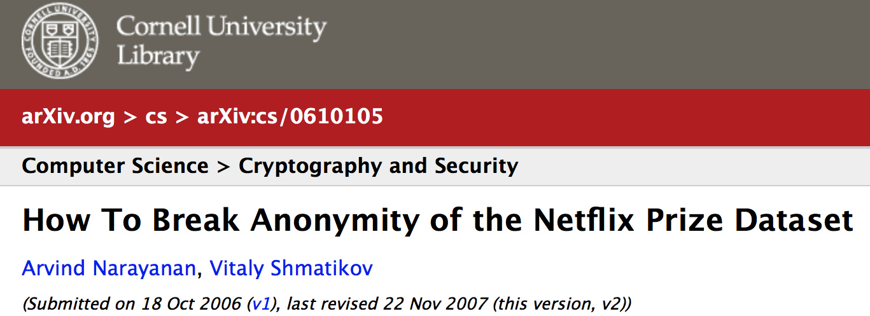

Privacy Attacks (2000-2010)
Notes:
A not-so-recent anymore example is that of Netflix. Unfortunately, it is the cannonical example and I have to include It for the sake of completion of the talk!
Netflix published a supposedly denonymized dataset in 2008. They were so over-confident that they put a prize money on it. Frankly, if they had not, I am sure no one would have bothered and this slide would not exist. Cheers to the over-confidence of Netflix.
Less than a year into the future came along two scientists who showed a way to denonymize Netflix using IMDB, which is publicly available! There goes one million dollar in the gutter and made this slide a reality!
This is not just one off incident. Few years ago, people were able to denonymize health record of the gov of Mass.
And not that long ago (Jan), people showed that data collected from strava can be used to infer us military base.
So privacy leak can be innocuous or can have serious damages to national security.

Slide 6
http://randomwalker.info/data-privacy/
Notes:
In fact, I would refer you all to have a look at this webpage. It has a list of many of the recent attacks. This webpage is by no means exhaustive, but surely has a comprehensive list.

Slide 7
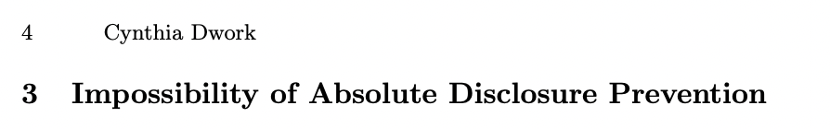
Use Cryptography?
➢ SMPC
➢ Homomorphic encyrption
➢ Functional encryption
➢ Arithmetic on finite fields
Notes:
A not-so-recent anymore example is that of Netflix. Unfortunately, it is the cannonical example and I have to include It for the sake of completion of the talk!
Netflix published a supposedly denonymized dataset in 2008. They were so over-confident that they put a prize money on it. Frankly, if they had not, I am sure no one would have bothered and this slide would not exist. Cheers to the over-confidence of Netflix.
Less than a year into the future came along two scientists who showed a way to denonymize Netflix using IMDB, which is publicly available! There goes one million dollar in the gutter and made this slide a reality!
This is not just one off incident. Few years ago, people were able to denonymize health record of the gov of Mass.
And not that long ago (Jan), people showed that data collected from strava can be used to infer us military base.
So privacy leak can be innocuous or can have serious damages to national security.

Slide 8
Why strong privacy guarantee?
Richer the data, more useful it is
Reidentification is not the only risk
Query auditing can be problematic
Summary statistics is not safe!!!
Ordinary facts are not okay!
Differential privacy addresses the paradox of learning nothing about individual while learning (statistics) about the population​
Notes:
This is all good! We now have a privacy definition, but a definition is good if we can use it.
We consider three problems that have applications in many areas of computer science and mathematics.
The first problem we study is robust PCA. One of the reasons why we study robust PCA is that the output is robust against outliers in data, i.e., given a low matrix that is corrupted by some sparse noise matrix, we can compute the low-rank matrix,
The second problem we study is clustering, where we are given n points in high dimension and are required to output k centers such that at least one of these centers are close to the original n points.
The third problem we study is graph Sparsification, where we are given a dense graph and we wish to output a sparse graph with edges almost n.

Slide 9
Defining Privacy: Attempt 1 (statistician view)
I am releasing research findings that people who lost their jobs are very likely to vote for X
You cannot do that; my friends knows that I lost my job recently!
Statistician’s nightmare!
Notes:
So, once we have established that privacy of data is serious concern, let us go back to the drawing board.
Often, when statistician or learning people collects data to be able to infer something in the future. One example is election.
Now, suppose a statistician figures it out that people who lost their jobs in past few years are most likely to vote for Mr. X

Slide 10
Defining Privacy: Attempt 1 (statistician view)
“nothing about individual should be learnable from the data that cannot be learned without access to the data”
- T. Delanius, 1977
Notes:
In fact, Delanius tried to formulate privacy to address this.
Unfortunately, Cynthia showed that such strong privacy guarantee is not possible if you wish to have any reasonable utility out of your collected data.

Slide 11
Defining Privacy: Attempt 2 (k-anonymity)
K people are on food stamps and social care, and all of them also voted for X
I know Jalaj is on food stamp and social care
Notes:
So, back to the drawing board.
Blend individual in the crowd: k-anonymity.
Unfortunately, again auxiliary information can be used to breach privacy.

Slide 12
Defining Privacy: Differential Privacy
I am releasing findings that people who lost their jobs are likely to vote for X
Do not blame if your friends know that you lost your job
Please participate in the survey truthfully as you have nothing to lose
The outcome would not tell that you participated or not => whom you voted
Statistician 😊 and participant 😊
Notes:
Perhaps, we are missing something. What was our goal? Our goal was to learn something based on current data.
It is not his problem that your friend knows you lost your job!
But I can say that you participate in survey truthfully.
What I can guarantee that ….

Slide 13
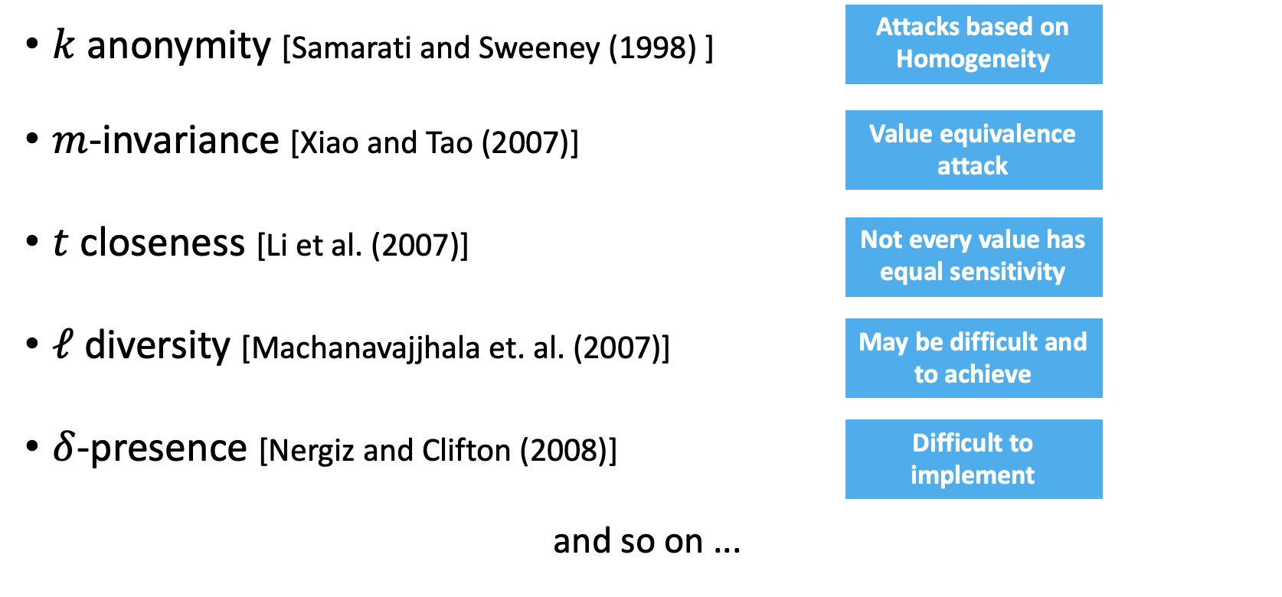
Defining Privacy: Other definitions

Slide 14
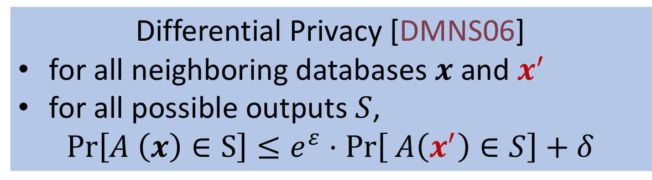
Defining Privacy: Differential Privacy
Captures what is private
x’ is a neighbor of x
If they differ in one row
The outcome would not tell that you participated or not
Differential Privacy [DMNS06]
for all neighboring databases $x$ and $x^{′}$
for all possible outputs $S$,
$$\operatorname{Pr}\left[A \left(x\right)∈S\right]≤e^{ε}⋅\operatorname{Pr}\left[ A\left(x^{′}\right)∈S\right]+δ$$
Captures all possible outcome
Notes:
This all led to the definition of differential privacy.

Slide 15
Properties of Differential Privacy
Preserved under post-processing
+
Preserved under composition
Can use simple algorithms to build complex systems
Notes:
This is all good! We now have a privacy definition, but a definition is good if we can use it.

Slide 16
DP in other fields
Learning with DP gives better generalization
DP algorithms and amazing mechanism design
Robust statistics
Robust sublinear space algorithms
Notes:
This is all good! We now have a privacy definition, but a definition is good if we can use it.
We consider three problems that have applications in many areas of computer science and mathematics.
The first problem we study is robust PCA. One of the reasons why we study robust PCA is that the output is robust against outliers in data, i.e., given a low matrix that is corrupted by some sparse noise matrix, we can compute the low-rank matrix,
The second problem we study is clustering, where we are given n points in high dimension and are required to output k centers such that at least one of these centers are close to the original n points.
The third problem we study is graph Sparsification, where we are given a dense graph and we wish to output a sparse graph with edges almost n.

Slide 17

An early example: From 1965
Wagner's randomized response
Flip an unbiased coin
If tails, respond truthfully
If head, flip another coin
If head, respond “YES”
If tail, respond “NO”
Differential privacy comes from plausible deniability
Notes:
This is all good! We now have a privacy definition, but a definition is good if we can use it.
We consider three problems that have applications in many areas of computer science and mathematics.
The first problem we study is robust PCA. One of the reasons why we study robust PCA is that the output is robust against outliers in data, i.e., given a low matrix that is corrupted by some sparse noise matrix, we can compute the low-rank matrix,
The second problem we study is clustering, where we are given n points in high dimension and are required to output k centers such that at least one of these centers are close to the original n points.
The third problem we study is graph Sparsification, where we are given a dense graph and we wish to output a sparse graph with edges almost n.

Slide 18
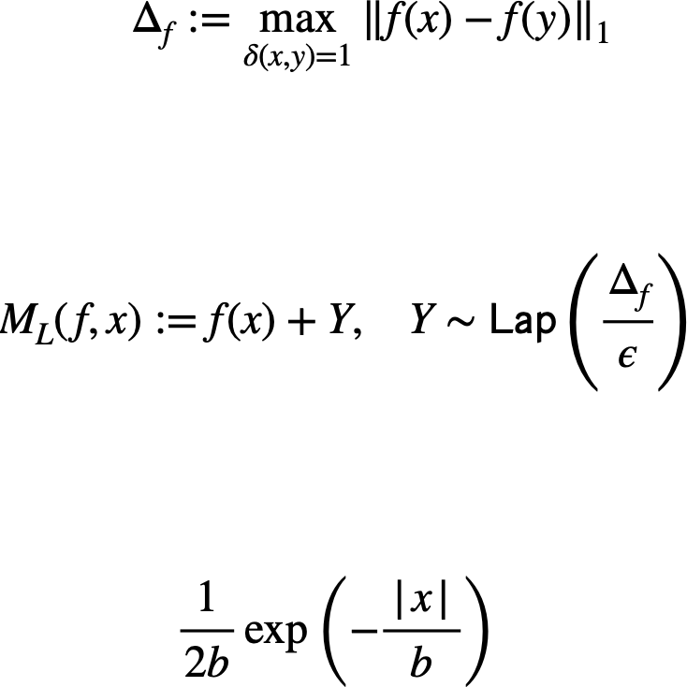
Fast forward 2006: Laplace mechanism
Given a query function f such that
Compute
Recall the pdf of Laplace distribution with scale b is
Notes:
This is all good! We now have a privacy definition, but a definition is good if we can use it.
We consider three problems that have applications in many areas of computer science and mathematics.
The first problem we study is robust PCA. One of the reasons why we study robust PCA is that the output is robust against outliers in data, i.e., given a low matrix that is corrupted by some sparse noise matrix, we can compute the low-rank matrix,
The second problem we study is clustering, where we are given n points in high dimension and are required to output k centers such that at least one of these centers are close to the original n points.
The third problem we study is graph Sparsification, where we are given a dense graph and we wish to output a sparse graph with edges almost n.

Slide 19
Privacy proof of Laplace mechanism
Notes:
This is all good! We now have a privacy definition, but a definition is good if we can use it.
We consider three problems that have applications in many areas of computer science and mathematics.
The first problem we study is robust PCA. One of the reasons why we study robust PCA is that the output is robust against outliers in data, i.e., given a low matrix that is corrupted by some sparse noise matrix, we can compute the low-rank matrix,
The second problem we study is clustering, where we are given n points in high dimension and are required to output k centers such that at least one of these centers are close to the original n points.
The third problem we study is graph Sparsification, where we are given a dense graph and we wish to output a sparse graph with edges almost n.

Slide 20
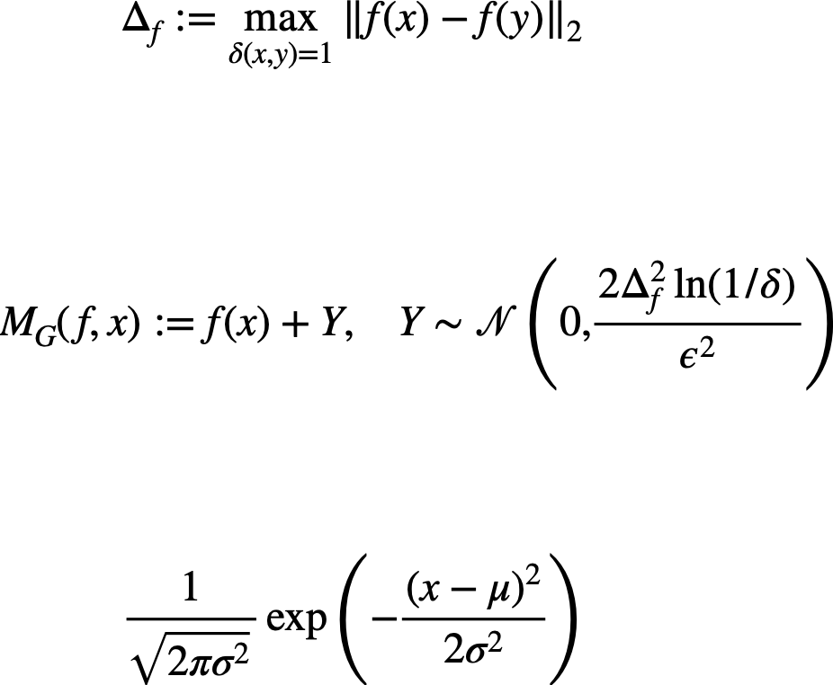
Fast forward 2006: Gaussian mechanism
Given a query function f such that
Compute
Recall the pdf of Gaussian distribution is
Notes:
This is all good! We now have a privacy definition, but a definition is good if we can use it.
We consider three problems that have applications in many areas of computer science and mathematics.
The first problem we study is robust PCA. One of the reasons why we study robust PCA is that the output is robust against outliers in data, i.e., given a low matrix that is corrupted by some sparse noise matrix, we can compute the low-rank matrix,
The second problem we study is clustering, where we are given n points in high dimension and are required to output k centers such that at least one of these centers are close to the original n points.
The third problem we study is graph Sparsification, where we are given a dense graph and we wish to output a sparse graph with edges almost n.

Slide 21
Fast forward: 2007
Exponential mechanism (generally impractical; used as a benchmark)
Need to chose best response
Noise destroys its value (think AUCTION)
Define utility function for each response
Notes:
This is all good! We now have a privacy definition, but a definition is good if we can use it.
We consider three problems that have applications in many areas of computer science and mathematics.
The first problem we study is robust PCA. One of the reasons why we study robust PCA is that the output is robust against outliers in data, i.e., given a low matrix that is corrupted by some sparse noise matrix, we can compute the low-rank matrix,
The second problem we study is clustering, where we are given n points in high dimension and are required to output k centers such that at least one of these centers are close to the original n points.
The third problem we study is graph Sparsification, where we are given a dense graph and we wish to output a sparse graph with edges almost n.

Slide 22
Fast forward: 2009
Sparse vector technique (think counting queries)
Only care about identity of elements above threshold
Add noise and report only if the noisy answer is above threshold
Notes:
This is all good! We now have a privacy definition, but a definition is good if we can use it.
We consider three problems that have applications in many areas of computer science and mathematics.
The first problem we study is robust PCA. One of the reasons why we study robust PCA is that the output is robust against outliers in data, i.e., given a low matrix that is corrupted by some sparse noise matrix, we can compute the low-rank matrix,
The second problem we study is clustering, where we are given n points in high dimension and are required to output k centers such that at least one of these centers are close to the original n points.
The third problem we study is graph Sparsification, where we are given a dense graph and we wish to output a sparse graph with edges almost n.

Slide 23
Fast forward: 2010
Private Multiplicative Weight Update Mechanism (think counting queries)
Answer exponential number of counting queries
Add correlated noise
Notes:
This is all good! We now have a privacy definition, but a definition is good if we can use it.
We consider three problems that have applications in many areas of computer science and mathematics.
The first problem we study is robust PCA. One of the reasons why we study robust PCA is that the output is robust against outliers in data, i.e., given a low matrix that is corrupted by some sparse noise matrix, we can compute the low-rank matrix,
The second problem we study is clustering, where we are given n points in high dimension and are required to output k centers such that at least one of these centers are close to the original n points.
The third problem we study is graph Sparsification, where we are given a dense graph and we wish to output a sparse graph with edges almost n.

Slide 24
Private multiplicative weight
Notes:
This is all good! We now have a privacy definition, but a definition is good if we can use it.
We consider three problems that have applications in many areas of computer science and mathematics.
The first problem we study is robust PCA. One of the reasons why we study robust PCA is that the output is robust against outliers in data, i.e., given a low matrix that is corrupted by some sparse noise matrix, we can compute the low-rank matrix,
The second problem we study is clustering, where we are given n points in high dimension and are required to output k centers such that at least one of these centers are close to the original n points.
The third problem we study is graph Sparsification, where we are given a dense graph and we wish to output a sparse graph with edges almost n.

Slide 25
Some other model of privacy
Local model of privacy [2006]
RAPPOR
Apple 2016 annoucement
Microsoft telemetry data
LinkedIn, Amazon, Twitter, …..
Shuffle model of privacy [2015]
Based on "Cryptography through Anonymity"
Notes:
This is all good! We now have a privacy definition, but a definition is good if we can use it.
We consider three problems that have applications in many areas of computer science and mathematics.
The first problem we study is robust PCA. One of the reasons why we study robust PCA is that the output is robust against outliers in data, i.e., given a low matrix that is corrupted by some sparse noise matrix, we can compute the low-rank matrix,
The second problem we study is clustering, where we are given n points in high dimension and are required to output k centers such that at least one of these centers are close to the original n points.
The third problem we study is graph Sparsification, where we are given a dense graph and we wish to output a sparse graph with edges almost n.

Slide 26
Some other model of computation
Continual release model [2010]
A lot of recent activities...
Pan privacy [2010]
Related to "Shuffle model of privacy"
Notes:
This is all good! We now have a privacy definition, but a definition is good if we can use it.
We consider three problems that have applications in many areas of computer science and mathematics.
The first problem we study is robust PCA. One of the reasons why we study robust PCA is that the output is robust against outliers in data, i.e., given a low matrix that is corrupted by some sparse noise matrix, we can compute the low-rank matrix,
The second problem we study is clustering, where we are given n points in high dimension and are required to output k centers such that at least one of these centers are close to the original n points.
The third problem we study is graph Sparsification, where we are given a dense graph and we wish to output a sparse graph with edges almost n.

Slide 27
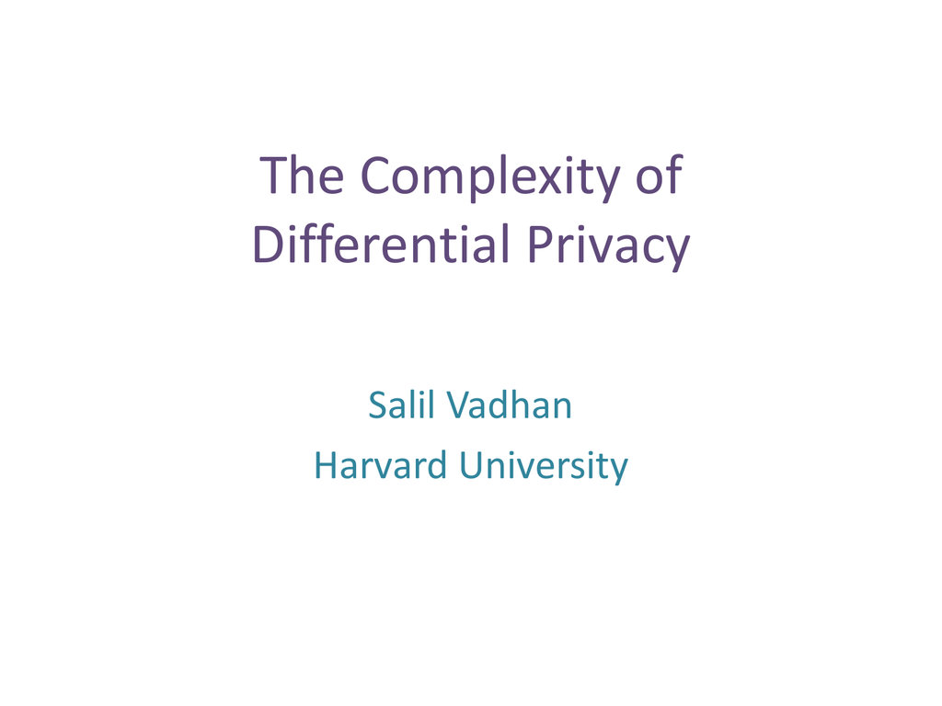

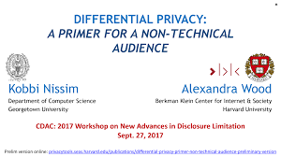
Resources
An upcoming book
Notes:
This is all good! We now have a privacy definition, but a definition is good if we can use it.
We consider three problems that have applications in many areas of computer science and mathematics.
The first problem we study is robust PCA. One of the reasons why we study robust PCA is that the output is robust against outliers in data, i.e., given a low matrix that is corrupted by some sparse noise matrix, we can compute the low-rank matrix,
The second problem we study is clustering, where we are given n points in high dimension and are required to output k centers such that at least one of these centers are close to the original n points.
The third problem we study is graph Sparsification, where we are given a dense graph and we wish to output a sparse graph with edges almost n.

